Slide 1
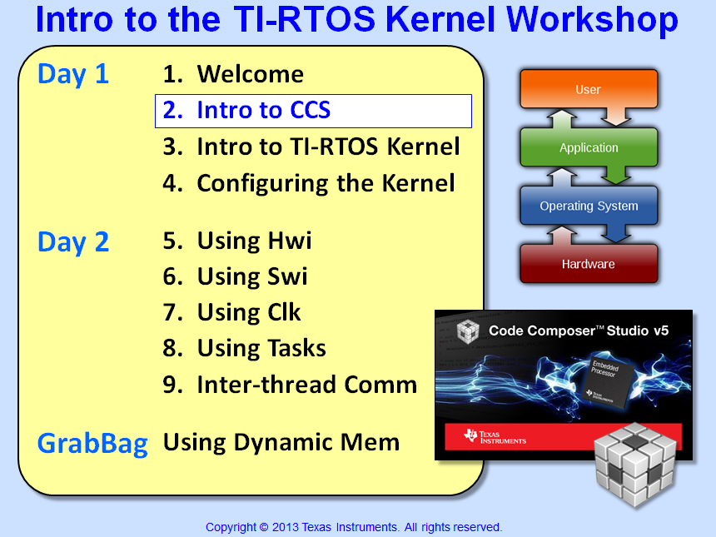

Slide 2
Objectives
Describe the fundamentals of Code ComposerStudio (CCS) v6
Demonstrate new features of CCSv6 such as workspaces, perspectives and views
Learn how to create a new CCS project
Describe the target and emulator options
Analyze the different CCS licensing options
Lab – Create, build and debug a “blink LED” example using CCSv6

Slide 3
TI Software and Tools Ecosystem
Run-Time Software
Development Tools
High-level O/S support and TI-RTOS
O/S Independent support and TI-Wares software packages
CCStudio™ Integrated Development Environment (IDE) and other IDEs
Optimizing compilers
Design Kits & Eval Modules
Support & Community
TI Design Network: off-the-shelf software, tools & services
Forums & Wikis
In-person and online training
Run-Time Software …
Notes:
Development tools like Code Composer and evaluation products like the LaunchPad board are just a part of TI’s support ecosystem for it’s processors.
Run-time software support includes TivaWare for C Series as well as TI’s RTOS called SysBios.
There is a rich community of support for TI’s products through the forums, e2e pages, Wikis, in-person and on-line training.

Slide 4
Run-Time Software
TI Wares: Minimizes programming complexity w/optimized drivers & O/S independent support for TI solutions:
Low-level driver libraries
Peripheral programming interface
Tool-chain agnostic C code
TI-RTOS: Provides an optimized real-time kernel that works with TI Wares:
Real-time kernel (SYS/BIOS) – most CPUs: - Scheduling - Memory management - Utilities
Foundational software packages (TI Wares)
Libraries and examples
TI-RTOS SDK available for Tiva-C, MSP430, C6000, C28x, Sitara (Cortex A8)
IAR support available now
TI-RTOS
Kernel
(SYS/BIOS)
TI Wares
File systems
Network stack
USB
+
+
SDK (Software Development Kit)
Ok, let’s go look at CCS …
Notes:
TI’s run time software support includes TI Wares and TI-RTOS
TI Wares like TivaWare minimize programming complexity with low level driver libraries and peripheral driver libraries. They can be used with multiple development environments.
TI’s RTOS is comprised of an optimized real-time kernel called SysBios. SysBios is optimized for TI devices and includes scheduling, memory management, instrumention and is fully compatible with TivaWare. Programming of USB and Ethernet ports is made easier with file systems and stacks.

Slide 5
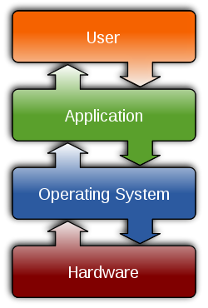
Outline
Intro to CCSv6
Functional Overview
Perspectives
Target Config & Emulators
Workspaces & Projects
Creating a Project
Build Config & Options
Licensing/Pricing
CCSv6 – For More Info…
Lab

Slide 6
Outline
Intro to CCSv6
Functional Overview
Perspectives
Target Config & Emulators
Workspaces & Projects
Creating a Project
Build Config & Options
Licensing/Pricing
CCSv6 – For More Info…
Lab

Slide 7
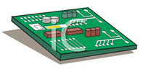
CCS Functional Overview
Compiler
Standard Runtime Libraries
SYS/BIOS
Libraries
Target Cfg File
.asm
.c
.lib
LaunchPad
Edit
.asm
Asm
.obj
Link
.out
Debug
EVM
SYS/BIOS
Config
(.cfg)
User.cmd
.map
EMU
Bios.cmd
Integrated Development Environment (IDE) based on Eclipse
Integrated “Debugger” and “Editor” – IDE Edit and Debug have the own “perspectives” (menus, windows)
Contains all development tools – editors, compilers, linkers, BIOS and debugger
Perspectives...
Notes:
.sa is “serial assembly”, i.e. linear assembly.

Slide 8
Outline
Intro to CCSv6
Functional Overview
Perspectives
Target Config & Emulators
Workspaces & Projects
Creating a Project
Build Config & Options
Licensing/Pricing
CCSv6 – For More Info…
Lab

Slide 9
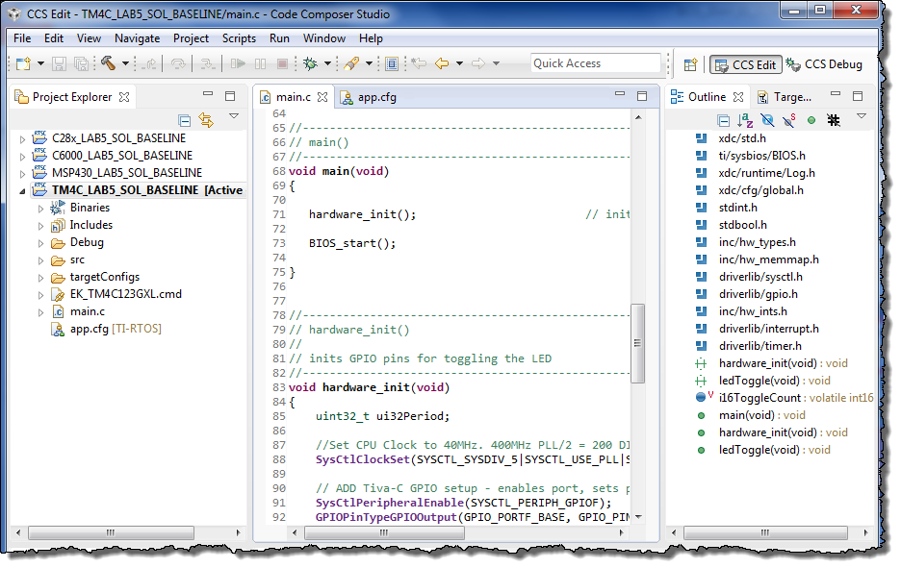
CCSv6 GUI – EDIT Perspective
Menus & Buttons
Specific actions related to EDITing
Perspectives
EDIT and DEBUG
Project Explorer
Project(s)
Source Files
Source EDITing
Tabbed windows
Color-coded text
Outline View
Declarations and functions
If you click on the "Debug" perspective, the windows change to...
Notes:
CCSv5 helps greatly with this problem.
You can customize your menus and toolbars to show just the items you care about.
Tabbed Editor windows make it easier to switch between files.
You can tab any view with another to organize your window layout.
The fast view setting can be applied to a view. What this does is hides the view down I the bottom status bar but when you click on it, it instantly opens and can be as big as you want.
Perspectives are a great feature in that they allow you to store different arrangements of windows depending on what you are doing. In CCSv5 we include 2 perspectives for you. The C/C++ perspective has items setup for building and editing. The debug perspective has the views you need to debug your application. You can customize these or even create your own!
9

Slide 10
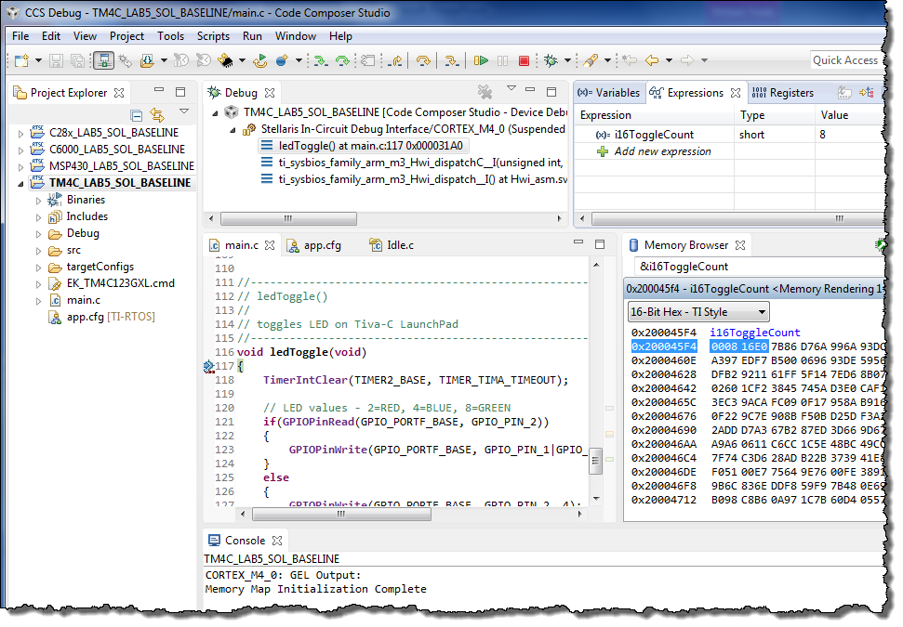

CCSv6 GUI – DEBUG Perspective
Connection Type
Specified in Target Cfg file
What options do users have when connecting to a target?
Menus & Buttons
Related to DEBUGing
Run, Suspend, Terminate
DEBUG Windows
Watch Variables
Memory Browser
PC execution point
Console Window
Notes:
CCSv5 helps greatly with this problem.
You can customize your menus and toolbars to show just the items you care about.
Tabbed Editor windows make it easier to switch between files.
You can tab any view with another to organize your window layout.
The fast view setting can be applied to a view. What this does is hides the view down I the bottom status bar but when you click on it, it instantly opens and can be as big as you want.
Perspectives are a great feature in that they allow you to store different arrangements of windows depending on what you are doing. In CCSv5 we include 2 perspectives for you. The C/C++ perspective has items setup for building and editing. The debug perspective has the views you need to debug your application. You can customize these or even create your own!
10

Slide 11
Outline
Intro to CCSv6
Functional Overview
Perspectives
Target Config & Emulators
Workspaces & Projects
Creating a Project
Build Config & Options
Licensing/Pricing
CCSv6 – For More Info…
Lab

Slide 12
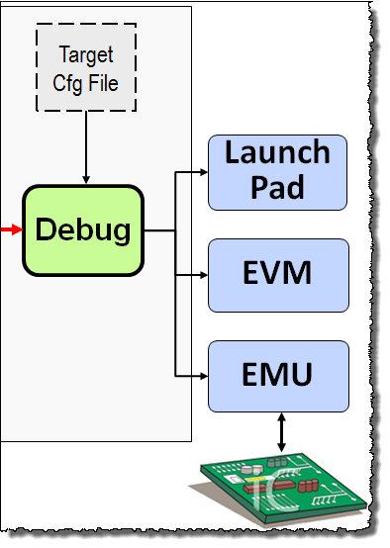
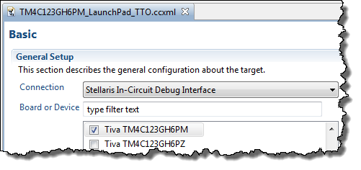
Target Configuration and Emulators
The Target Configuration File specifies:
Connection to the target (XDS, FET, etc.)
Target device (e.g. TM4C123, C28027, etc.)
GEL file (if applicable) for h/w setup
EMU Connection Options
Built-in and external emulators from TI, Blackhawk, Spectrum Digital and others
XDS100v1/v2, 200, 510, 560, 560v2
MSP-FET430
JTAG Emulators...

Slide 13
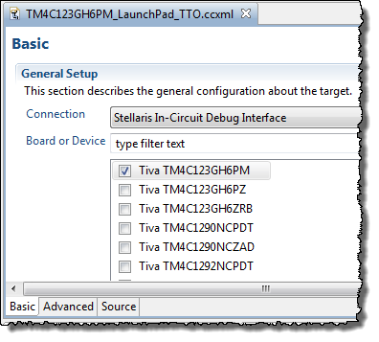
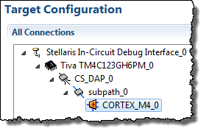
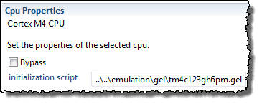
Creating a New Target Config File (.ccxml)
Target Configuration – defines your “target” – i.e. emulator/device used, GEL scripts (replaces the old CCS Setup)
Create user-defined configurations (select based on chosen board)
Advanced Tab
“click”
Specify GEL script here
More on GEL files...

Slide 14
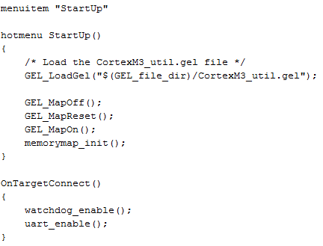
What is a GEL File ?
GEL – General Extension Language (not much help, but there you go…)
A GEL file is basically a “batch file” that sets up the CCS debug environment including:
Memory Map
Watchdog
UART
Other periphs
The board manufacturer (e.g. SD or LogicPD) supplies GEL files with each board.
To create a “stand-alone” or “bootable” system, the user must write code to perform these actions (optional chapter covers these details)

Slide 15

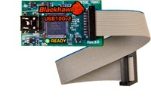
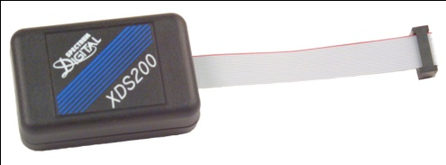
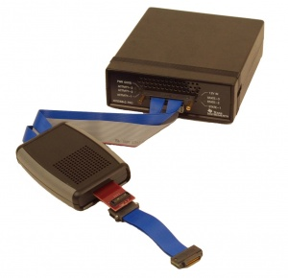
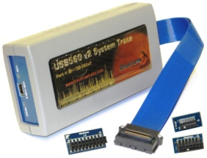
JTAG Emulators
Entry level JTAG emulator
USB interface
3 models based on JTAG headers (14pin TI, 20pin TI, 20/10pin ARM)
$79
Excellent balance of performance and cost
USB interface (Ethernet version available)
20pin TI, 14pin TI, 20pin ARM and 10pin ARM connectors
$295
XDS100v2
XDS200
High performance JTAG emulator
USB or USB + Ethernet interfaces
Includes multiple JTAG adapters (14pin TI, 20pin TI, 20pin ARM, 60pin MIPI, some include 60pin TI)
System Trace
$995 - $1495
Trace Receiver & XDS560v2 JTAG emulator
USB + Ethernet interfaces
MIPI60 and 60pin TI adapters
DSP & ARM Trace to pins
System Trace
$3495
XDS560v2
Pro Trace

Slide 16
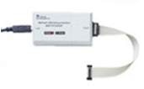

MSP430 JTAG Emulators
USB Interface
Compatible with CCS, IAR and other debuggers
$99
Parallel Port Interface
Compatible with CCS, IAR and other debuggers
$49
MSP-FET430UIF
MSP-FET430PIF

Slide 17
Outline
Intro to CCSv6
Functional Overview
Perspectives
Target Config & Emulators
Workspaces & Projects
Creating a Project
Build Config & Options
Licensing/Pricing
CCSv6 – For More Info…
Lab

Slide 18
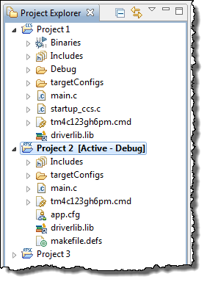
Workspaces and Projects (GUI)
WORKSPACE
Source
PROJECT
Looking more closely at Projects and Workspaces...

Slide 19
Projects and Workspaces
Workspace
Project 1
Project 2
Project 3
Settings/preferences
Project
Source Files
Header Files
Library Files
Build/tool settings
Link
Source Files
Code and Data
Link
Link
Header Files
Declarations
Link
Library Files
Code and Data
Workspace \folder contains:
IDE settings and preferences
Projects can reside in the workspace folder or be linked from elsewhere
When importing projects into the workspace, linking is recommended
Deleting a project from the Project Explorer only deletes the link
Project \folder contains:
Build and tool settings (for use in managed MAKE projects)
Files can be linked to or reside in the project folder
Deleting a linked file from Project Explorer only deletes the link
Example of linked library:

Slide 20
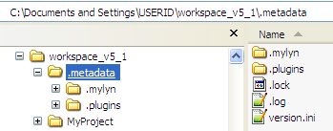
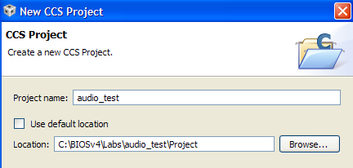
Eclipse “Workspace”
Workspace – a “container” for Eclipse metadata and the default location for all projects
Default Location (as shown):
Can change workspace location if desired
User can also locate projects in specific folders:

Slide 21
Outline
Intro to CCSv6
Functional Overview
Perspectives
Target Config & Emulators
Workspaces & Projects
Creating a Project
Build Config & Options
Licensing/Pricing
CCSv6 – For More Info…
Lab

Slide 22
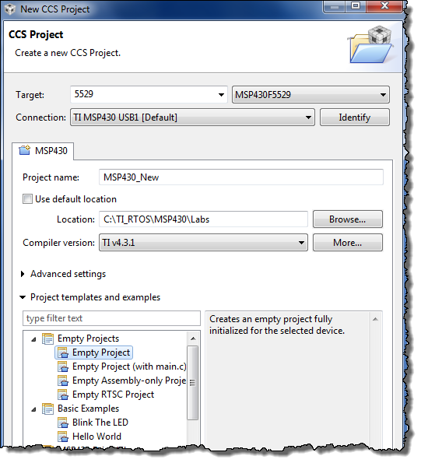
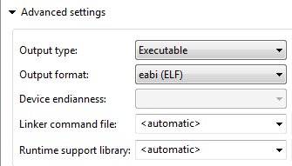
Creating a New Project
Project→New CCS Project
(in Edit perspective…)
Connection
If target is specified, user can choose “connection” (i.e. the target config file)
Project Location
Default = workspace
Manual = anywhere you like
Templates
No BIOS? Choose “Empty”
BIOS? Choose BIOS template
Adding files to the project…

Slide 23



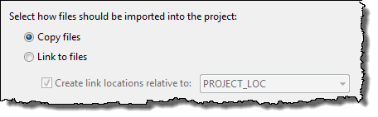
Adding Files to a Project
Users can ADD (copy or link) files into their project
SOURCE files are typically COPIED
LIBRARY files are typically LINKED (referenced)
1
Right-click on project and select:
2
Select file(s) to add to the project:
3
Select “Copy” or “Link”
COPY
Copies file from original location to project folder (two copies)
LINK
References (points to) source file in the original folder
Can select a “reference” point – e.g. PROJECT_LOC or user- defined VARIABLE (portable)
Build Configuraitons and Options...

Slide 24
Outline
Intro to CCSv6
Functional Overview
Perspectives
Target Config & Emulators
Workspaces & Projects
Creating a Project
Build Config & Options
Licensing/Pricing
CCSv6 – For More Info…
Lab

Slide 25

Compiler Build Options
Nearly 100 compiler options available to tune your code’s performance, size, etc.
The following table lists the most commonly used options:
 | Options | Description
 | -mv7M4 | Generate Cortex M4 code
 | -vmsp | Generate MSP430 code
Debug | -g | Enables src-level symbolic debugging
 | -ss | Interlist C statements into assembly listing
Optimize (release) | -o3 | Invoke optimizer (-o0, -o1, -o2/-o, -o3)
 | -mf/-ms | Speed/code size tradeoff (-mf M4/MSP, -ms C28/C6000)
 | -k | Keep asm files, but don't interlist
To make things easier, TI has created two BUILD CONFIGURATIONS:
Debug (-g, no opt) – great for LOGICAL debug
Release (no –g, opt) – great for PERFORMANCE
Users can create their own custom build configs
How do you CHANGE compiler options?
Notes:
-ms can be used for the C28x/C6000 to reduce code size.

Slide 26
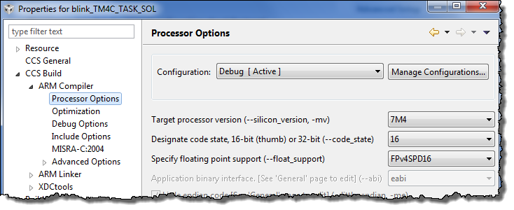
Modifying Build Configurations
Select the build configuration: Debug or Release
Right-click on the project and select Properties
Then click “Processor Options” or any other category (like Opt):

Slide 27
Outline
Intro to CCSv6
Licensing/Pricing
CCSv6 – For More Info…
Lab

Slide 28
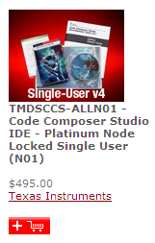
CCSv6 Licensing and Pricing
Licensing
Wide variety of options (node locked, floating, time based)
All versions (full, DSK, free tools) use same image
Updates readily available online
Licenses are “perpetual” – subscriptions only needed to upgrade to next major release (CCSv5 to CCSv6)
Pricing
Reasonable – includes FREE options noted below
Annual subscription - $99 ($159 for floating)
Item | Description | Price | Annual
Platinum Eval Tools | Full tools with 90 day limit (all EMU) | FREE
Platinum Bundle | XDS100 use (EVM/LP) or Simulator | FREE ☺
Platinum Node Lock | Full tools tied to a machine | $495 (1) | $99
Platinum Floating | Full tools shared across machines | $795 (1) | $159
MSP430 Code-Limited | MSP430 (16KB code limit, GCC) | FREE
☺ - recommended option: purchase Dev Kit (LP, etc), use XDS100v1-2, & Free CCSv5/6
Managing your CCS license...
Notes:
Tiva-C LP uses the XDS100 free licence. MSP430 has 3 options: free eval, 16KB code limit or GCC (no code limit).

Slide 29
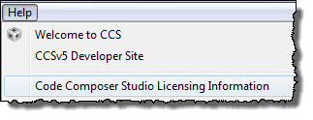
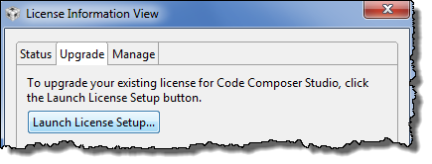
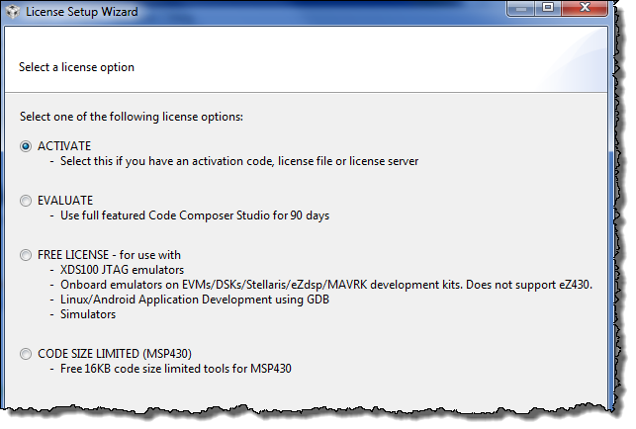
Changing CCS User License
If, for some reason, you need to change the licensing of CCS to a different type:
Your options here will vary based on the installed targets

Slide 30
Outline
Intro to CCSv6
Licensing/Pricing
CCSv6 – For More Info…
Lab

Slide 31

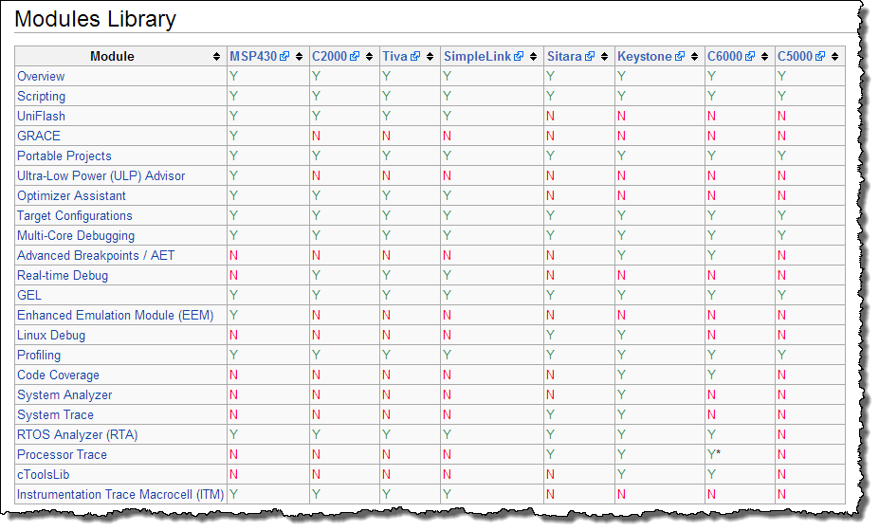
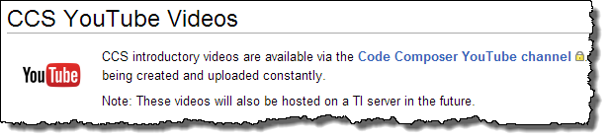
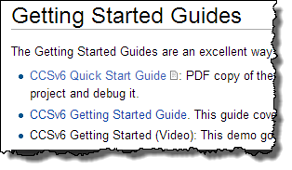
CCSv6 – For More Information
http://processors.wiki.ti.com/index.php/Category:CCS_Training

Slide 32


Development Tools for Tiva-C MCUs
Eval Kit License | 30-day full function. Upgradeable | 32KB code size limited. Upgradeable | 32KB code size limited. Upgradeable | Full function. Onboard emulation limited
Compiler | GNU C/C++ | IAR C/C++ | RealView C/C++ | TI C/C++
Debugger / IDE | gdb / Eclipse | C-SPY / Embedded Workbench | µVision | CCS/Eclipse-based suite
Full Upgrade | 99 USD personal edition / 2800 USD full support | 2700 USD | MDK-Basic (256 KB) = €2000 (2895 USD) | 445 USD
JTAG Debugger |  | J-Link, 299 USD | U-Link, 199 USD | XDS100, 79 USD
Notes:
32
32
32
Stellaris microcontrollers are supported by four different integrated development environments: Mentor graphics Mentor-Embedded tools, IAR systems Embedded Workbench tools, the ARM Keil Microvision tool, and Texas Instruments Code Composer Studio tool. You can see the eval kit licenses there. Some of them offer 30-day full function. Some of them are code-size limited.
The Code Composer Studio version is full function, but it's onboard emulation limited. If you use and connect the LaunchPad board to your computer, you have full function capability of Code Composer Studio. Only if you go off to use a target board do you need to actually buy the tool.
For the compilers, you can see that some companies use the GNU tool. Some of them use their own tool. TI has their own C C-plus-plus compiler, although C-plus-plus is not supported on embedded microcontrollers because of the large sizes that it can generate.
For the debugger IDE, two of the tools offer Eclipse base support. Eclipse is the open source workbench tool that's been out there for quite some time. Full upgrade on these devices or rather on these tools for the mentor-embedded tool. 99 bucks for the personal addition, 2,800 if you want full support. For the IAR systems tool, about 2,700 dollars. For ARM Keil, about 2,900 dollars.
Code Composer Studio, the pricing is 445 dollars for the downloadable version. If you want the CD, it's 495 dollars. Most of the companies offer JTAG debuggers, and there are also third-party debuggers out there. IAR systems offer a J-link for about 300 bucks. ARM Keil for about 200 bucks. And Texas Instruments has the XDS100, an entry level tool, for about 80 bucks. We also offer the 200 and the 500 versions ... they have additional capabilities at an additional cost.

Slide 33
Outline
Intro to CCSv6
Functional Overview
Perspectives
Target Config & Emulators
Workspaces & Projects
Creating a Project
Build Config & Options
Licensing/Pricing
CCSv6 – For More Info…
Lab

Slide 34
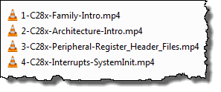

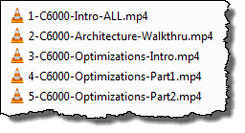

If You Finish Early…
Everyone gets through labs at a different pace. That’s just fine.
But what happens if you get done sooner than the rest of the group? You have OPTIONS:
Do the OPTIONAL Lab (if it exists)
Watch architecture videos for YOUR target:
1
2
From your \VIDEOS_Architecture folder, click on these in order:

Slide 35
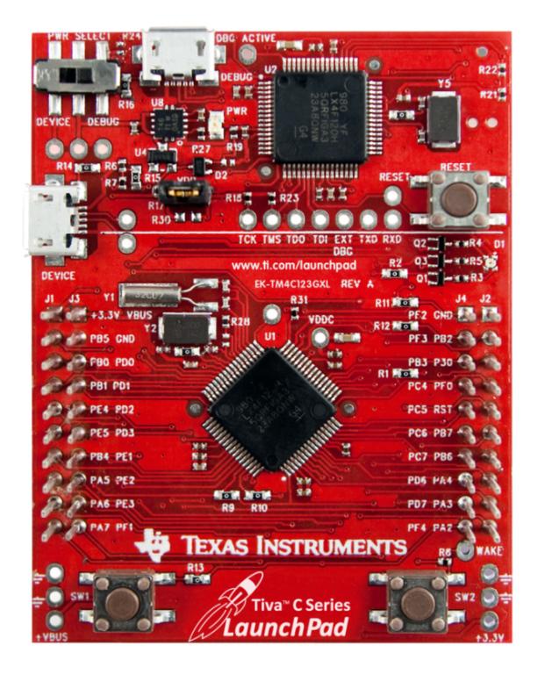

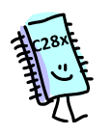
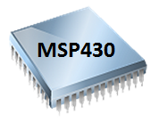

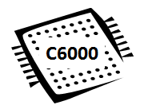
Lab 2 – MCU “Hello World” – Blink an LED
Lab Goal:
You are new to CCSv6 and simply want to BLINK AN LED (the “hello world” of MCU) on your target board – and learn a few things about the IDE
Lab 2 – Blink LED (no BIOS)
Create a new project
Add (copy) main.c
Add (link/copy) driver “library”
Add linker.cmd file
Build, load, debug
Architecture “Markers”
Some labs contain architecture “markers” that differentiate specific instructions for your target
Pay close attention to these:
Note: project creation/debug slides at end of lab
Time: 45min

Slide 36


Slide 37
New Project Creation – C28x
Shown below is a summary of the steps to create a new C28x project
Refer to CCS/BIOS chapters/labs for specific screen shots and steps:
File → New → CCS Project. Then fill in all target-specific items including Connection type. Use “variant” to filter device list.
Project path: for TI-RTOS workshop labs, choose \labx\Project for your project location (do not use default workspace path)
Device Variant = controlSTICK – Piccolo F28069, Connection = Texas Instruments XDS100v1 USB Emulator
Project Template: For BIOS app, choose TI-RTOS → Kernel → Target → Minimal template. For non-BIOS app, use “Empty Project”
Next/Finish: If BIOS app, click “Next” to configure tools – choose latest tools: XDC, TI-RTOS, UIA. If non-BIOS app, click Finish.
File Mgmt: If necessary, delete main.c provided by New Project Wizard and add (copy) source files to project as directed in lab.
Linker Command File: Double-check that a linker.cmd file has been added already – e.g. TMS320F28069.cmd
Header Files linker.cmd: Add add’l linker.cmd file (if BIOS app, choose F2806x_Headers_BIOS.cmd from controlSuite)
ControlSuite Source files: Add controlSUITE source files – if TI-RTOS workshop lab, add folder \Eware_F28069_BIOS (Right-click on project, select Import, expand General, choose File System, Next, browse to folder location, check checkbox)
Edit vars.ini: Modify vars.ini to match your exact controlSUITE path for CONTROLSUITE_F2806x_INSTALL = your path
Import vars.ini: if not already done once for workspace, import vars.ini by choosing File → Import → CCS → Build Variables, then click Next, browse to vars.ini location, check box for “Overwrite existing values”, click Finish to import var into workspace
Add Include Search Paths: right-click on your project, select Properties, select Build → Compiler → Include Options. Then use your variable – CONTROLSUITE_F2806x_INSTALL – to add the following paths: ${CONTROLSUITE_F2806x_INSTALL}/f2806x_common/include ${CONTROLSUITE_F2806x_INSTALL}/f2806x_headers/include
Add Pre-defined Symbol: If BIOS project, right-click on project and select Properties. Select C2000 Compiler → Advanced Options → Predefined Symbols, click the “+” sign to add a new NAME and type “xdc__strict” using TWO underscores “__”, click Ok.
Modify Boot Settings: open app.cfg, in the Outline view, click BIOS → System Overview → Boot, click “Add C28x boot…” checkbox, set DIV setting = 18 to provide 90MHz clock. Save app.cfg.

Slide 38
New Project Creation – C6000
Shown below is a summary of the steps to create a new C6000 project
Refer to CCS/BIOS chapters/labs for specific screen shots and steps:
File → New → CCS Project. Then fill in all target-specific items. Use “variant” to filter device list (LCDKC6748)
Project path: for TI-RTOS workshop labs, choose \labx\Project for your project location (do not use default workspace path)
Device Variant = LCDKC6748, Connection = BLANK (will be chosen via User Defined Target Config File using EMU)
Use ELF Output Format: TI-RTOS for C6000 only supports ELF. Click Advanced Settings and change output format to ELF.
Project Template: For BIOS app, choose TI-RTOS → Kernel → Target → Minimal . For non-BIOS app, choose “Empty Project”
RTSC Settings: If BIOS app, click “Next” to configure tools – choose latest tools –XDC, TI-RTOS, UIA. Choose the proper platform file (ti.platforms.evm6748) located at \xdctools_rev#\packages\ti\platforms. If non-BIOS app, just click Finish.
File Mgmt: If necessary, delete main.c provided by New Project Wizard and add (copy) source files to project as directed in lab.
Linker Command File: No add’l linker files needed.
Edit vars.ini: Modify vars.ini to match your exact PDK install path for PDK_INSTALL = your install path
Import vars.ini: if not already done once for workspace, import vars.ini by choosing File → Import → CCS → Build Variables, then click Next, browse to vars.ini location, check box for “Overwrite existing values”, click Finish to import var into workspace
Add Include Search Path: right-click on your project, select Properties, select Build → Compiler → Include Options. Then use your variable – PDK_INSTALL – to add the following path: ${PDK_INSTALL}/packages
Add Driver Library: If CSL is used – no library is necessary

Slide 39
New Project Creation – MSP430
Shown below is a summary of the steps to create a new MSP430 project
Refer to CCS/BIOS chapters/labs for specific screen shots and steps:
File → New → CCS Project. Then fill in all target-specific items. Use “variant” to filter device list.
Project path: for TI-RTOS workshop labs, choose \labx\Project for your project location (do not use default workspace path)
Device Variant = MSP430F5529, Connection = TI MSP430 USB1
Project Template: BIOS app? Use TI-RTOS → Driver→ 5529 LP→ Example→ Empty template. Non-BIOS? Use “Empty Project”
RTSC Settings: If BIOS app, click “Next” to configure tools – choose latest XDC, TI-RTOS, UIA. If non-BIOS app, click Finish
File Mgmt: If necessary, delete main.c provided by New Project Wizard and add (copy) source files to project as directed in lab.
Linker Command File: Double check that the proper linker.cmd file has been added to your project.
Edit vars.ini: Modify vars.ini to match your exact MSP430Ware path for MSP430WARE_INSTALL = your TI-RTOS install path
Import vars.ini: if not already done once for workspace, import vars.ini by choosing File → Import → CCS → Build Variables, then click Next, browse to vars.ini location, check box for “Overwrite existing values”, click Finish to import var into workspace
Add Include Search Path: right-click on your project, select Properties, select Build → Compiler → Include Options. Then use your variable – MSP430WARE_INSTALL – to add the following path: ${MSP430WARE_INSTALL}/driverlib/MSP430F5xx_6xx
Add Driver Library: When using TI-RTOS, links for the driver library and include search paths is done FOR you. If not using TI-RTOS, Link in the driver library code by doing the following: right-click on project, select Import, expand General, click on File System and click Next. Browse to MSP430Ware location (same location as pointed to by your variable), choose the folder MSP430F5xx_6xx (NOT the “FR” version), check this folder in the dialogue, check “create top-level folder”, click Finish.
Turn off ULP Advisor: Properties → Build → MSP430 Compiler → ULP Advisor, click None.

Slide 40
New Project Creation – Tiva-C
Shown below is a summary of the steps to create a new Tiva-C project
Refer to CCS/BIOS chapters/labs for specific screen shots and steps:
File → New → CCS Project. Then fill in all target-specific items. Use “variant” to filter device list.
Project path: for TI-RTOS workshop labs, choose \labx\Project for your project location (do not use default workspace path)
Device Variant = TM4C123GH6PM, Connection = Stellaris In-Circuit Debug Interface
Project Template: BIOS app? Use TI-RTOS→ Driver→ TM4C LP→ Ex→ Empty template. Non-BIOS app?, choose “Empty Project”
RTSC Settings: If BIOS app, click “Next” to configure tools – choose latest XDC, TI-RTOS, UIA. If non-BIOS app, click Finish
File Mgmt: If necessary, delete main.c provided by New Project Wizard and add (copy) source files to project as directed in lab.
Linker Command File: Double check that the proper linker.cmd file has been added to your project.
Edit vars.ini: Modify vars.ini to match your exact TIVAWare install path for TIVAWARE_INSTALL = your install path
Import vars.ini: if not already done once for workspace, import vars.ini by choosing File → Import → CCS → Build Variables, then click Next, browse to vars.ini location, check box for “Overwrite existing values”, click Finish to import var into workspace
Add Include Search Path: right-click on your project, select Properties, select Build → Compiler → Include Options. Then use your variable – TIVAWARE_INSTALL – to add the following path: ${TIVAWARE_INSTALL}
Add Driver Library: Link in the driver library code by doing the following (for the main driverlib plus any other libraries needed: add (link) the following file RELATIVE to your variable TIVAWARE_INSTALL: ${TIVAWARE_INSTALL}\driverlib\ccs\debug\driverlib.lib

Slide 41
Checklist – When Things Go Wrong
Shown below is a checklist you can use when you get build errors (build) or you are unable to connect to the target (debug)
Build Problems
Chose wrong device variant when project was created (open project Properties and modify)
C28x – did not include the additional linker command file for the header files (add file to project)
No include search paths or search path incomplete (check Properties → Build → Compiler → Include Options). Also double-check entire path from the include search path specified plus the additional paths in your source files to make sure the paths are correct.
If using variables and vars.ini to set linked resource and build paths, may need to edit and/or re-import vars.ini – edit file, then select File → Import → CCS → Build Variables, browse to vars.ini and open
Forgot to add the driver library for your specific target and/or linked it improperly
Changed build configurations (Debug to Release) and forgot to copy all settings from one configuration to the other (they are SEPARATE containers of build options)
Build does not seem to grab changes. Clean project (right-click on project, clean, then rebuild again).
BIOS: did not start w/BIOS template (re-create project using BIOS template and add source files)
BIOS: did not use updated BIOS/compiler tools (Properties → General/RTSC tabs, make sure latest tools are chosen)
BIOS: C6000 – forgot to specify platform file (Properties → RTSC tab, specify proper platform)
BIOS: runtime settings incorrect – double check BIOS → Runtime module in app.cfg
Debug/Connection Problems
Windows messed up or general odd behavior (either perspective): Use Windows → Reset Perspective !
Used wrong target configuration file and/or GEL file (open project Properties or User Defined Target Configurations and modify/relaunch)
“Bug” used for build/launch/connect/reload. This does not work sometimes – especially the first time. If you have problems, perform each step individually to find the problem. Your previous connection is stored in the .launches folder in your project directory. You can delete this folder and try the bug again. Or simply go through the steps ONCE and then use the bug after that – because CCS should remember your “previous” launch steps.
Did not properly terminate previous debug session. This can cause any number of errors. Close CCS, power cycle the board, relaunch CCS and relaunch debug session.
Workspace may be corrupt. Switch workspaces using File → Switch Workspace.
BIOS Runtime: use ROV to see the state of any problem area including stack overflow

Slide 42
Troubleshooting Checklist – For More Info
Shown below are several wiki pages that may help you debug your problem beyond the typical errors talked about on the previous pages…
BIOS Debug Tips http://processors.wiki.ti.com/index.php/DSP_BIOS_Debugging_Tips
Debugging Boot Issues http://processors.wiki.ti.com/index.php/Debugging_Boot_Issues
Debugging CCSv5 Projects http://processors.wiki.ti.com/index.php/GSG:Debugging_projects_v5
Troubleshooting CCSv5 http://processors.wiki.ti.com/index.php/Troubleshooting_CCSv5
Debugging JTAG Connectivity Problems http://processors.wiki.ti.com/index.php/Debugging_JTAG_Connectivity_Problems
CCS FAQ http://processors.wiki.ti.com/index.php/CCStudio_FAQ

Slide 43
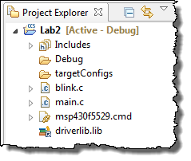
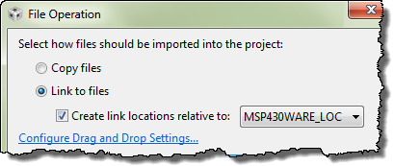
Portable Projects
Why make your projects “portable”?
Simplifies project sharing
You can easily re-locate your projects – or use source control tools
Allow simple changes to link to new releases of software libraries
Copied files are not a problem (they move with the project folder)
Linked files may be an issue - located outside the project folder, they may be referenced via:
absolute path, or
relative path
Choose a Path Variable for a relative path
What are these variables?

Slide 44
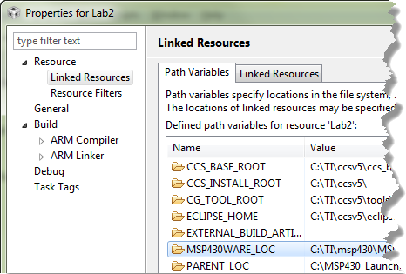

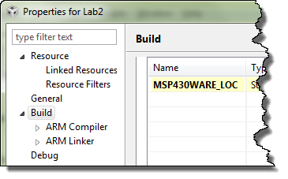
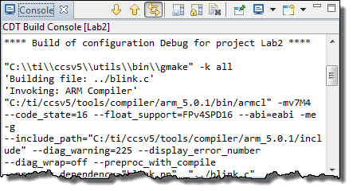
Two Types of Path Variables
Eclipse implements portable projects with two types of variables:
◆
Linked Path Variables
Linked path variables are for references to files linked to a project
❖
Build Path Variables
Build path variables are for references during builds
Use these var’s for tool search paths
Hint: To avoid confusion, always create both variables with the same name
Scope?

Slide 45
Variable Scope: Projects or Workspaces
PROJECT
Add path variables to each project
or
Add them to the workspace to make them available to all projects
WORKSPACE
Users can also import vars.ini containing path variables – auto sets WORKSPACE level vars
Note: See lab for “how to use” details
Notes:
If you import “macros.ini”, this will apply the variables to the active project only

Slide 46
Path Variables and Build Variables
Path Variables
Used by CCS (Eclipse) to store base path for relative linked files
Example: PROJECT_LOC is set to the path of your project, say c:/Tiva_LaunchPad_Workshop/lab2/project
Used as a reference point for relative path, e.g. ${PROJECT_LOC}/../files/main.c
Build Variables
Used by CCS (Eclipse) to store base path for build libraries or files
Example: CG_TOOL_ROOT is set to the path for the code generation tools (compiler/linker)
Used to find #include .h files, or object libraries, e.g. ${CG_TOOL_ROOT}/include or ${CG_TOOL_ROOT}/lib
How are these variables defined?
The variables in these examples are automatically defined when you create a new project (PROJECT_LOC) and when you install CCS with the build tools (CG_TOOL_ROOT) – nice!
What about TivaWare or additional software libraries? You can define some new variables yourself
How and where do I add these variables?

Slide 47
Adding Variables
Why are we doing this?
We could use PROJECT_LOC for all linked resources or PROJECT_ROOT as the base for build variables
It is “almost” portable, BUT if you move or copy your project, you have to put it at the same “level” in the file system
Defining a link and build variable for TivaWare location gives us a relative path that does NOT depend on location of the project (much more portable)
Also, if we install a new version of TivaWare, we only need to change these variables – much easier than creating new relative links
How to add Path and Build Variables
Project → Properties, expand the Resource category, click on Linked Resources. You will see a tab for Path Variables, click New to add a new path variable
Project → Properties, click on Build category, click on the Variables tab, Click New to add a new build variable
In the lab, we’ll add a path variable and build variable TIVAWARE_INSTALL to be the path of the latest TivaWare release
Note:
This method defines the variables as part of the project (finer control)
You can also define variables as part of your workspace (do it once)

Slide 48
Outline
MainHighlight
MainNormal
SubHighlight
SubNormal

